Slide 1
Simulation and Modeling
CSE4131_CSE4132

Slide 2
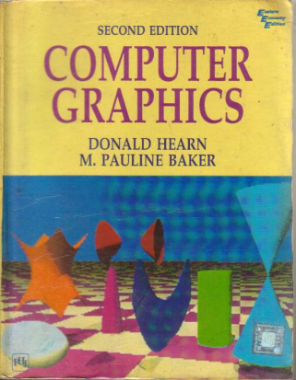
Reference Book
Computer Graphics (2nd Edition)
D. HEARN
M. P. BAKER

Slide 3
Some Commonly Used Splines
Some commonly used Splines and their matrix and blending-function specifications
Cubic Spline Interpolation Method
Natural Cubic Splines
Hermit Spline
Cardinal Splines
Kochanek-Bartels Splines

Slide 4
Kochanek-Bartels Splines
These interpolating cubic polynomials are extensions of the cardinal Splines.
Two additional parameters are introduced into the constraint equations defining Kochanek-Bartels splines to provide for further flexibility in adjusting the shape of curve sections.

Slide 5
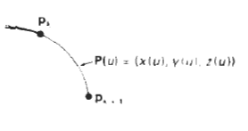
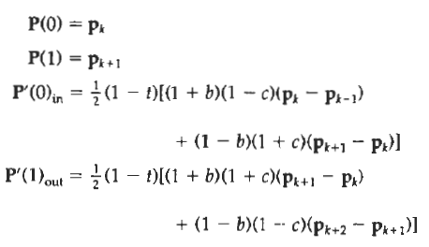
Kochanek-Bartels Splines
Given four consecutive control points, labeled p_{k-1}, p_{k}, p_{k+1}, and P_{k+2}, we define the boundary conditions for a Kochanek-Bartels curve section between p_{k} and p_{k+ I} as:
where t is the tension parameter, b is the bias parameter, and c is the continuity parameter.
In the Kochanek-Bartels formulation, parametric derivatives may not be continuous across section boundaries

Slide 6
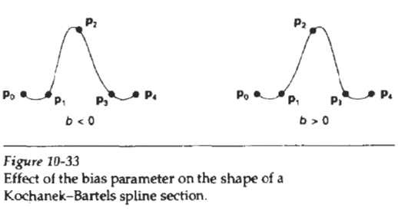
Kochanek-Bartels Splines
Tension parameter t has the same interpretation as in the cardinal-spline formulation;
that is, it controls the looseness or tightness of the curve sections.
Bias (b) is used to adjust the amount that the curve bends at each end of a section
so that curve sections can be skewed toward one end or the other (Fig. 10-33).
Parameter c controls the continuity of the tangent vector across the boundaries of sections.
If c is assigned a nonzero value, there is a discontinuity in the slope of the curve across section boundaries.

Slide 7
SPLINE
Spline
Interpolation
Cubic Spline Interpolation Method
Natural Cubic Splines
Hermit Spline
Cardinal Splines
Kochanek-Bartels Splines
Approximation
Bezier curves and surfaces
B-spline curves and surfaces
Beta-Splines
Rational Splines

Slide 8

BEZIER CURVES AND SURFACES
This spline approximation method was developed by the French engineer Pierre Bezier for use in the design of Renault automobile bodies.
Reasons of popularity:
Bezier Splines have a number of properties that make them highly useful and convenient for curve and surface design.
They are also easy to implement

Slide 9
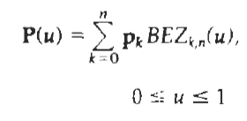


BEZIER CURVES AND SURFACES
Suppose we are given n + 1 control-point positions: p_{k} = (x_{k}, y_{k}, z_{k}), with k varying from 0 to n.
These coordinate points can be blended to produce the following position vector P(u), which describes the path of an approximating Bezier polynomial function between p₀ and p_{n}.
Eq. 10.40
Eq. 10.41
The Bezier blending functions BEZ_{k,n}(U) are the Bernstein polynomials:
where the C(n, k) are the binomial coefficients:
Eq. 10.42

Slide 10

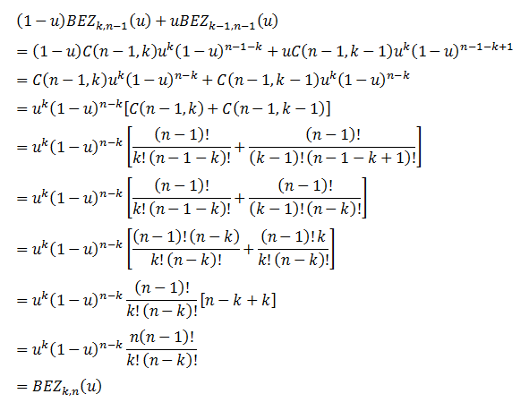
BEZIER CURVES AND SURFACES

Slide 11



Slide 12

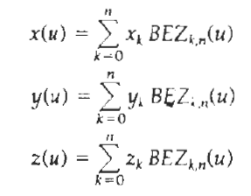
BEZIER CURVES AND SURFACES
Equivalently, we can define Bezier blending functions with the recursive calculation:
Vector equation 10-40 represents a set of three parametric equations for the individual curve coordinates
Eq. 10.40

Slide 13
BEZIER CURVES AND SURFACES
As a rule,
a Bezier curve is a polynomial of degree one less than the number of control points used:
Three points generate a parabola,
four points a cubic curve, and so forth.

Slide 14
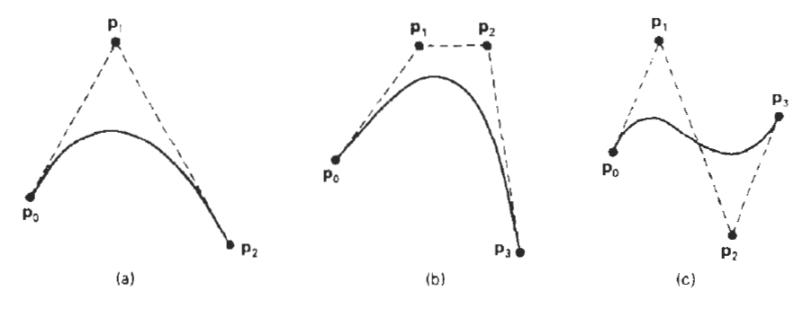
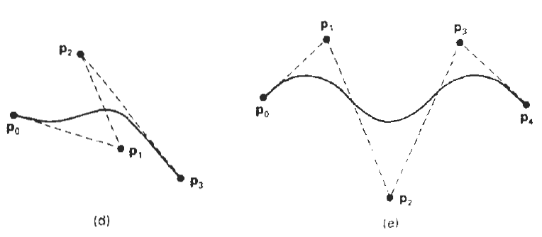
Some Examples

Slide 15
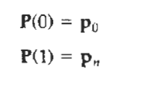
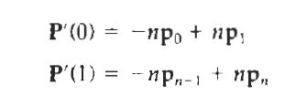
Properties of Bezier Curve
1# A very useful property of a Bezier curve is that it always passes through the first and last control points.
That is, the boundary conditions at the two ends of the curve are
2# The parametric first derivatives of a Bezier curve at the endpoints are calculated as:

Slide 16
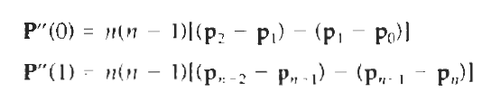
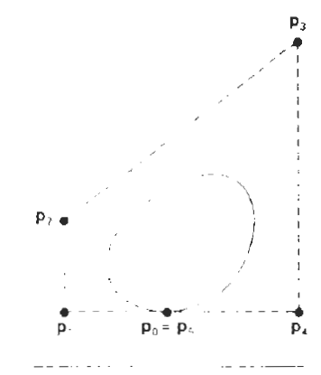
Properties of Bezier Curve
3# The parametric second derivatives of a Bezier curve at the endpoints are calculated as
4# Another important property of any Bezier curve is that it lies within the convex hull (convex polygon boundary) of the control points

Slide 17

Properties of Bezier Curve
5# The sum of Bezier blending function is 1
6# Bezier curve are tangent to their first and last edges of control graph.
7# Bezier curve follows the shape of the defining polygon.
8# No straight line intersects Bezier curve more times than it intersects its polygon.

Slide 18
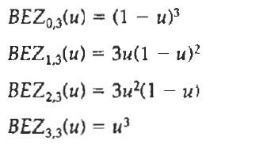
Cubic Bezier Curve
Cubic Bezier curves are generated with four control points.
The four blending functions for cubic Bezier curves, obtained by substituting n = 3 into Eq. 10-41.
How???

